Slide 1
Chapter 18
Virtual-Circuit Network: Frame relay
18.<number>

Slide 2
18-1 FRAME RELAY
Frame Relay is a virtual-circuit wide-area network that was designed in response to demands for a new type of WAN in the late 1980s and early 1990s.
Topics discussed in this section:
Architecture
Frame Relay Layers
Extended Address
FRADs
VOFR
LMI
18.<number>

Slide 3
Notes on Frame Relay:
Frame Relay operates at a higher speed, than X.25, 1.544 Mbps and recently 44.376),
It can be used a backbone network to protocols that already have network layer such as the Internet,
It allows bursty data,
Allows a frame size of 9000 bytes, which can accommodate all LAN frame sizes,
It is less expensive than other traditional WANs,
18.<number>

Slide 4
Continue; Notes on Frame Relay:
It has an error detection at the data link layer only. There is no flow control or error control and no even retransmission policy if a frame is damaged; it is silently dropped. Frame relay was designed in this way to provide fast transmission capability for more reliable media and for those protocols that have flow and error control at the higher layers.
18.<number>

Slide 5
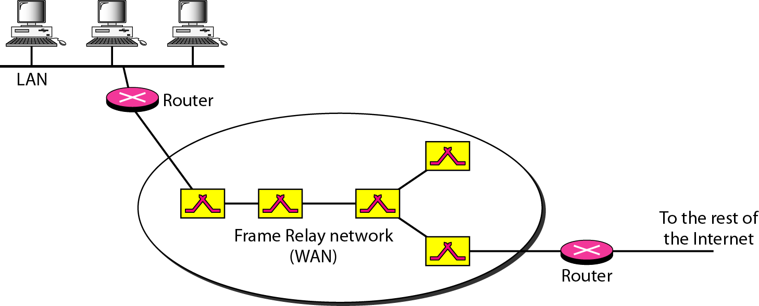
Figure 18.1 Frame Relay network
18.<number>

Slide 6

Note
VCIs in Frame Relay are called DLCIs.
18.<number>

Slide 7
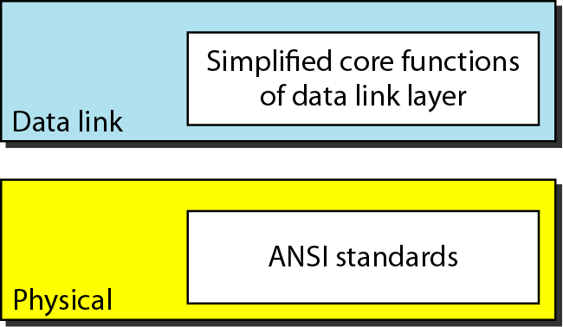
Figure 18.2 Frame Relay layers
18.<number>

Slide 8
Note
Frame Relay operates only at the physical and data link layers.
18.<number>

Slide 9
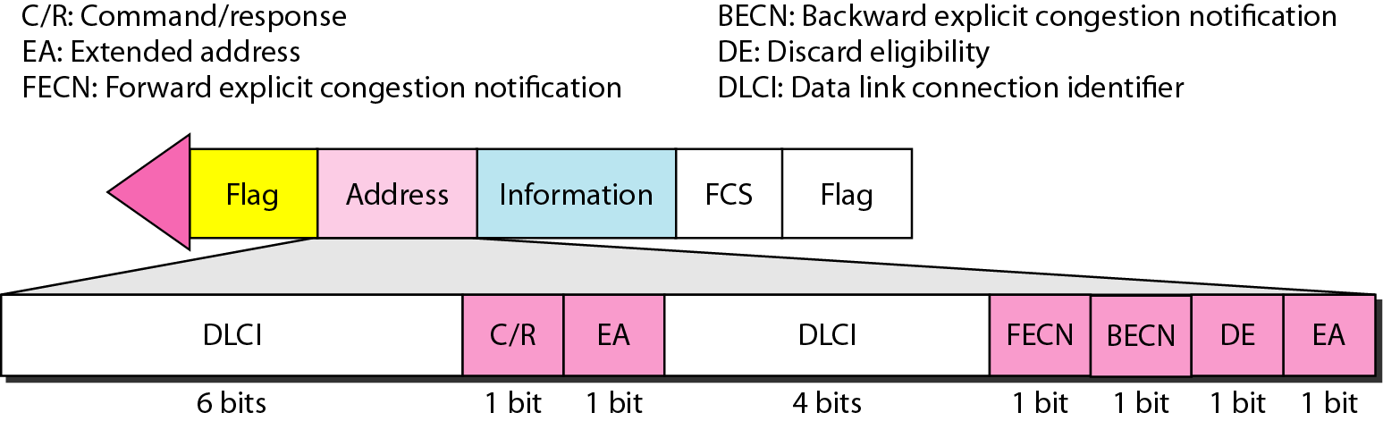
Figure 18.3 Frame Relay frame
18.<number>

Slide 10
Note
Frame Relay does not provide flow or error control; they must be provided
by the upper-layer protocols.
18.<number>

Slide 11
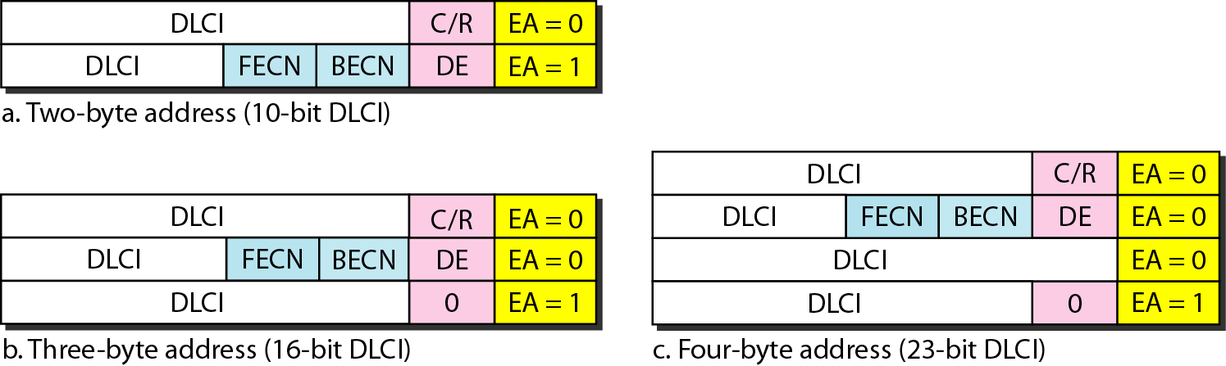
Figure 18.4 Three address formats
18.<number>

Slide 12
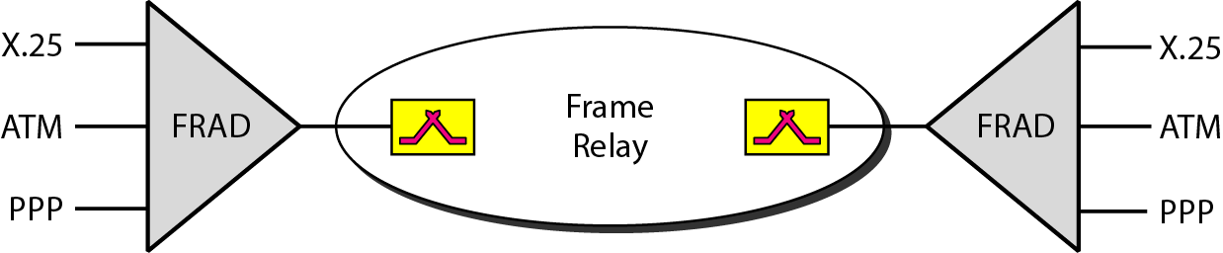
Figure 18.5 FRAD
18.<number>

Slide 13
Note
Frame Relay offers an option called voice over frame relay (VOFR) that sends voice through the network.
18.<number>

Slide 14
Note
Local management information (LMI) is a protocol added recently to the Frame Relay protocol to provide more management features.
18.<number>

Slide 15
LMI can provide:
A keep-alive mechanism to check if data are flowing,
A multicast mechanism to allow a local end system to send frames to more than one remote end system
A mechanism to allow an end system to check the status of a switch (e.g., to see if the switch is congested)
18.<number>

Slide 16
Note
Frame Relay provides congestion control and QoS.
18.<number>

